Slide 1

Contact Management Data Structures
An Engineering Analysis on Optimizing Dynamic Insertions, Deletions, and Search Operations
Presented by:
Pranav A S(192573001)

Slide 2

System Requirements
Architectural Demand for High-Frequency Dynamic Updates

Slide 3


System Requirements & Constraints
Dynamic Operations
Performance Standards
Contact records in modern applications are continuously added, updated, and deleted based on user activity. Static pre-allocations lead to severe memory waste or buffer overflow errors.
The system must ensure instantaneous search lookup while performing record updates without noticeable execution latency or $O(N)$ memory element shifting overhead.

Slide 4

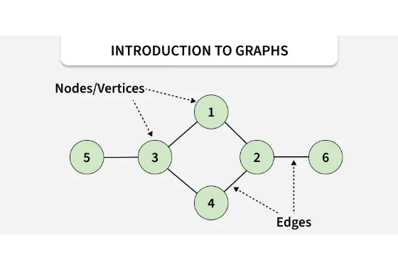
Dynamic Array Limitations
•
Arrays store elements in contiguous RAM locations, requiring rigid memory layouts.
•
Inserting or deleting a record requires shifting up to $N$ subsequent elements.
•
Dynamic resizing forces full array copies into new memory allocations.
•
Worst-case time complexity degrades significantly to $O(N)$.

Slide 5
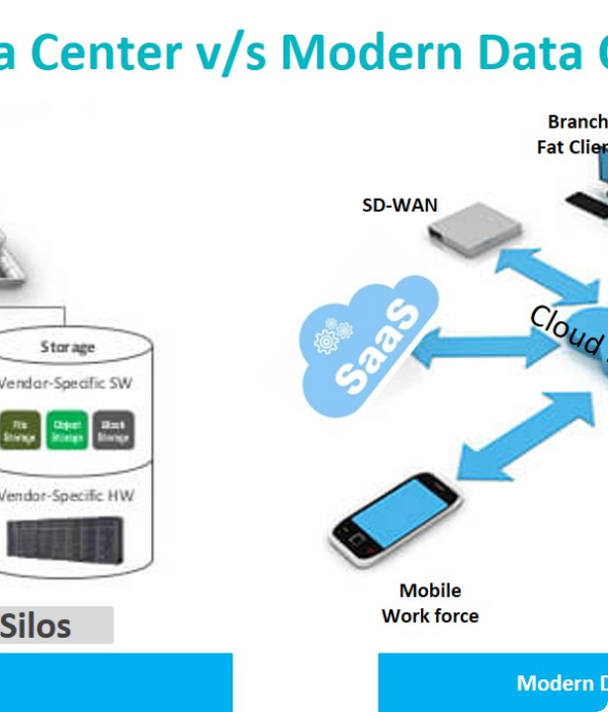

Pointer-Based Deletion
Doubly Linked List Advantage
A Doubly Linked List links nodes via forward and backward pointers, allowing direct element unhooking.
When given a node reference, deletion executes in $O(1)$ constant time without shifting memory.

Slide 6

Operational Efficiency Comparison
Hash Map + Doubly Linked List
O(1)
Combining a Hash Map (for index lookup) with a Doubly Linked List (for record storage) achieves true $O(1)$ constant time across both search and deletion phases.
This hybrid architecture represents the industry standard for production contact management engines.
Constant Time Deletion

Slide 7
Data Structure Complexity Comparison
Data Structure | Insertion | Deletion | Search | Memory Allocation
Array / Vector | O(N) | O(N) | O(1) / O(log N) | Contiguous Block
Singly Linked List | O(1) | O(N) | O(N) | Dynamic Nodes
Doubly Linked List | O(1) | O(1)* | O(N) | Dynamic Nodes
Hash Table + Doubly LL | O(1) | O(1) | O(1) Avg | Hybrid Allocation

Slide 8
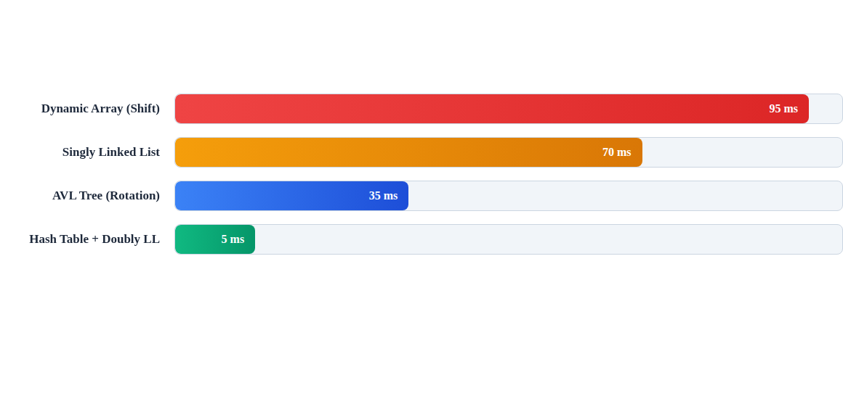
Relative Deletion Latency (Lower is Better)
Benchmarks highlight the dramatic latency drop when unhooking pointers via Hash Table + Doubly Linked List compared to contiguous array shifting.

Slide 9

Memory Allocation Footprint
The minor memory overhead of storing pointers is vastly outweighed by the runtime benefits gained during high-frequency updates.

Slide 10




Record Deletion Workflow
2. Unhook
4. Free Memory
Re-link previous and next neighbor pointers around node.
Deallocate heap memory block safely back to OS.
1. Query
3. Clear Index
Hash key lookup finds contact node pointer in O(1) time.
Remove hash map entry key to prevent dangling references.

Slide 11
Key Engineering Takeaways
Avoid arrays for dynamic datasets where frequent deletions or middle insertions occur.
Combine Hash Tables with Doubly Linked Lists for constant time $O(1)$ updates and searches.
Utilize Self-Balancing Trees (AVL/Red-Black) if real-time alphabetical sorting is mandatory.

Slide 12

Questions & Answers
Thank you for your time.
Data Structures & Systems Architecture Presentation

Slide 13


Image Sources
https://media.geeksforgeeks.org/wp-content/uploads/20251024112600799492/introduction_to_graphs.webp
Source: www.geeksforgeeks.org
https://www.kaigengroup.com/software-defined-datacenter/img/sddn12.jpg
Source: www.kaigengroup.com

